Slide 1
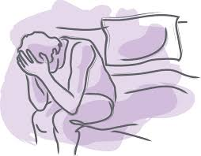
Male Factor Infertility
DR. ANURA DISSANAYAKE
DEPT. OF OBSTETRICS AND GYNAECOLOGY

Slide 2
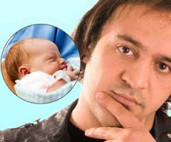
Contents
Definitions & classifications
Causes of male infertility
Evaluation and treatment options

Slide 3
Fecundity vs. Fertility
  Probability of conception in a fixed period of time (usually a year)
  Actual bearing of children -Depend upon age at marriage, duration of married life, spacing of children, economic status, nutrition, family planning, education, social and cultural factors
Infertility vs. Sterility
  Inability to conceive after one year (<35 yr) or six months (>35yr) of unprotected regular intercourse
  Involuntary childlessness even after the treatment

Slide 4


Primary vs. Secondary infertility
A couple has never been able to conceive
Couple has previously been conceived regardless of the outcome, and currently is unable to conceive

Slide 5
Effective classification
Male Female
Infertile
Fertile / Sub fertile
Multifactorial
subfertility

Slide 6
Causes of male Infertility
Pre testicular
  Environment / lifestyle factors
  Endocrine causes
  Chromosomal or Genetic causes
Testicular
  Infection
  Varicoceles
  Antisperm antibodies (ASA)
Post testicular
  Ejaculatory failure
  Erectile dysfunction

Slide 7


Envt. / lifestyle factors
Heat / tight underwear
Smoking
Alcohol
Recreational drugs
Certain medications (anabolic steroid)
Industrial chemicals, gases, heavy metals
Radiation
Stress
Overweight

Slide 8
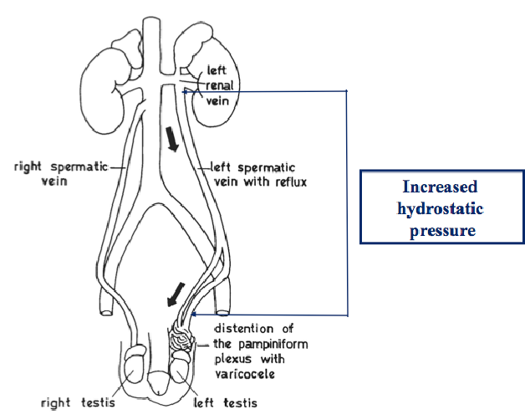
Varicoceles
Palpably dilated veins of the pampaniform plexus
Prevalence is around 25% of men with subnormal
semen
Majority are left sided (90%)
  Differences in veins drainage
  Reduced no. of valves
  Compression of left vein between the
  superior mesenteric vein and the aorta

Slide 9
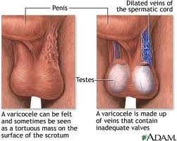
Classification
Grade I felt only on vulsalva manoeuvre
Grade II palpable without VM
Grade III Visible

Slide 10
Pathophysiology
  Increase in testicular T (poor heat exchange)
  Reflux of renal and adrenal metabolites
  Formation of ASA
  Oxidative stress (formation of free radicals)
  Minor changes in hypothalamo- pituitary axis (Inhibin Testosterone )
  Testicular atrophy / germ cell apoptosis
  Hypoxia ?

Slide 11
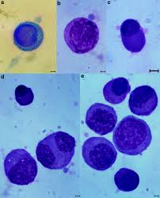
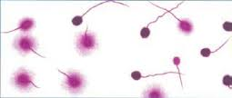
Effects on semen
  Reduced sperm count, motility, viability and morphology
  Increase in immature germ cells
  Plasma membrane damage due to lipid peroxidation by Reactive Oxygen Species (ROS)
  Sperm DNA damage

Slide 12
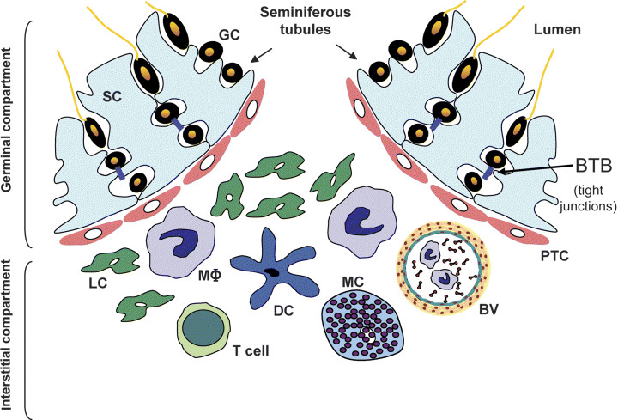
Anti-Sperm Antibodies (ASA)
Antigens produced by Spermatocytes and spermatozoa are foreign to the immune system
Immunoglobulins and immunocompetent cell are not allowed to enter the lumen of seminal vesicles by
  Blood testes barrier
  Intra epithelial lymphocytes
  Macrophages
  Immunomodulatory factors
  in semen (Prostaglandins,
  Cytokines, Polyamines, Zn)

Slide 13
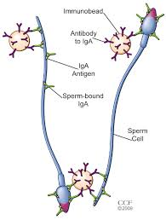
In abnormal conditions
ASA secrete in to the fluids of accessory sex glands
Prevalence 9-35% in subfertile men
Found in serum and cervical mucus of women
Three classes of immunoglobulins are implicated in male infertility
  IgM – not secrete in to the genital tract
        Large molecular size / found in serum
  IgG – enters in to the GT
  Attach to sperm
  IgA – Produce locally in the GT
        Not present in serum

Slide 14
Causes
  Obstruction of the epididymis or vas
  Trauma to the BTB
  Infection / inflammation
  Cryptorchidism
  Varicocele
  Malignancy
  Anal sex
  Surgical interventions
  Spinal cord injury

Slide 15
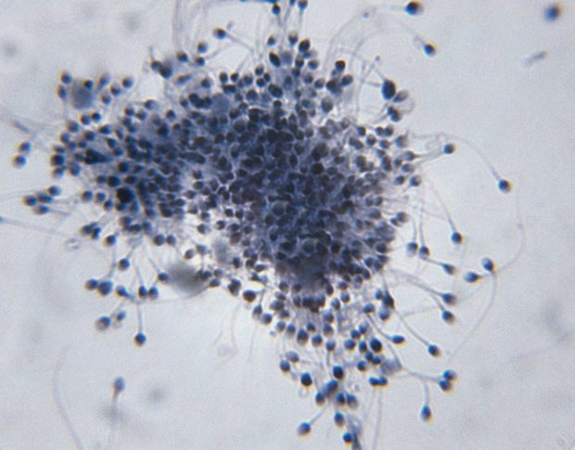
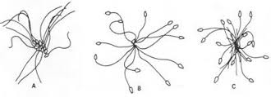
Effects on semen
  Sperm agglutination
  Reduction of ability to penetrate cervical mucus
  Destruction of sperm in the uterus by phagocytosis action
  Prevent sperm capacitation and acrosome reaction
  Block sperm bind to the ZP

Slide 16
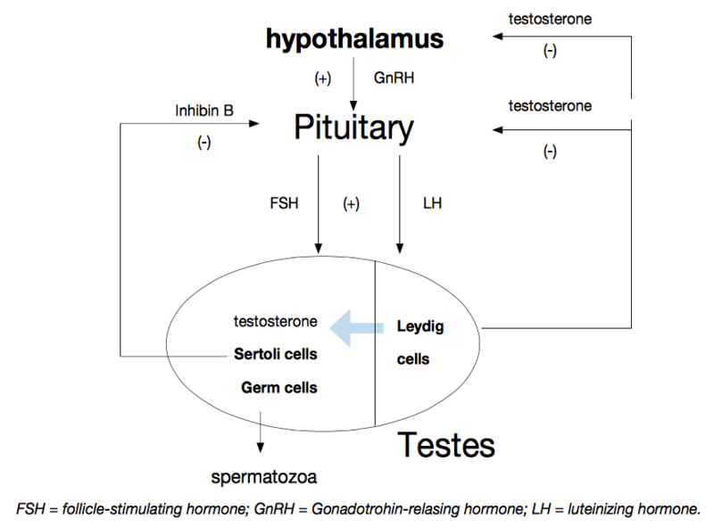
Endocrine disorders
Endocrinopathy present in up to 20%
5-10% of males the etiology is purely endocrine
Classified in to
  Hypogonadotropic -
  hypogonadism
  Hypergonadotropic -
  hypogonadism
  Hyperprolactinaemia

Slide 17
Hyperprolactinaemia
  Modulation of action of dopamine and TRH
  Infiltrative diseases (Tuberculosis)
  Micro/ macroadenomatous PRL secreting tumor
  Hypothyrodism
  Drug induced
  Acromegaly (excess GH)
  Chronic renal failure
  Stress
  Effects
  Decreased libido / impotence
  Disrupt GnRH release
  Oligozoospermia

Slide 18
Hypogonadotropic hypogonadism
Kallmans syndrome (Low FSH /LH/ T)
Isolated LH/FSH deficiency
Pituitary tumor
Plolactin excess
Panhypopituitarism
E2 (obesity, adrenal cortex or sertoli cell tumor)
Liver diseases
Haemochromatosis

Slide 19
Hypergonadotropic hypogonadism
  Klinefelters syndrome (High FSH/LH, Low T)
  Anorchia (vanishing testes syndrome)
  Sertoli cells only syndrome (germ cell aplasia)
  Cryptorchidism
  Androgen receptor defects (testicular feminization)
  Auto-immune disorders
  Orchitis (Mumps/Tuberculosis)
  Varicocele
  Radiation/chemotherapy/torsion

Slide 20
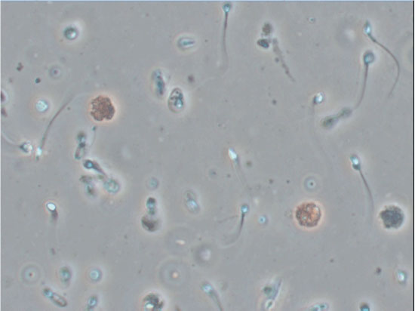
Infection
Suspect with the presence of peroxidase positive leucocytes >1 mn/mL in semen
Commonly isolated organisms
Chlamydia trachomatis
Ureaplasma urialiticum
Mycobacterium tuberculosis
Proteus mirabils
Mycoplasma hominis
Escherichia coli
Enterococcus

Slide 21
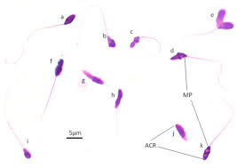
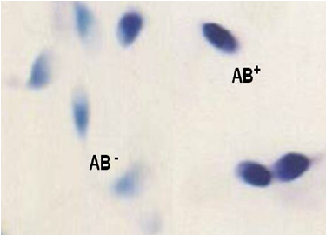
Effects on semen
  Increase in viscosity
  Reduction of volume
  Increase ROS and DNA damage
  Changes in biochemical composition
  Production of ASA
  Low sperm maturity
  OAT with reduced viability

Slide 22
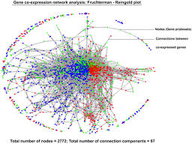
Genetics causes
Spermatogenesis is regulated by about 2000 genes
Majority are present on the autosomes
30 genes identified on Y chromosome
Genetic factors manifest as
  Chromosoamal disorders
  Endocrine disorders
  Multifactorial disorders

Slide 23
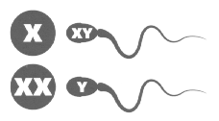
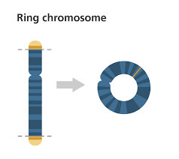
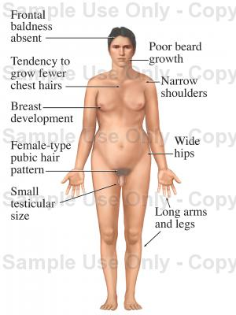
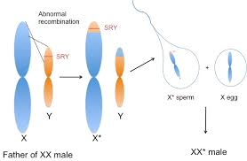
Chromosoaml abnormalities
  Numerical
Klinefelter syndrome (47 XXY -Azoospermia)
(47XXY /46XY – Oligo-Azo)
  Structural
Ring / dicentric Y chromosome
Translocations (XX males)
(Oligo – Azoo)

Slide 24
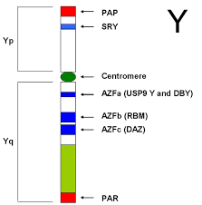
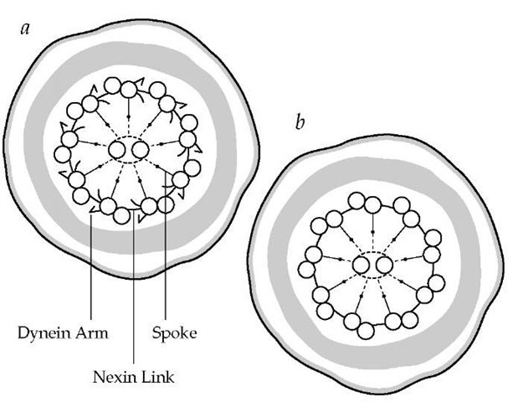
Gene mutations
Y micro deletions (AZF region)
DAZ gene
Kallmann’s syndrome (X linked)
AR receptor gene (androgen resistance)
5 alpha reductase gene
Kartagener syndrome (Immotile cilia
syndrome - chromosome 1)
CFTR mutation (CBAVD – chromosome 7)

Slide 25
Ejaculatory disorders
Aspermia
  Anejaculation
  Retrograde ejaculation (RE)
  Retarded ejaculation
Azoospermia with low volume
  Partial retrograde ejaculation
  Absence of vas deference
  Obstruction
Azoospermia with normal volume
  Obstruction at the epididymal level

Slide 26
Anejaculation
  Spinal cord injury
  Diabetic neuropathy
  open bladder neck
  Multiple sclerosis
  Psychological factors
  Traumatic (Surgery)

Slide 27
Retrograde ejaculation
  Congenital wider bladder neck
  Diabetics
  Paraplegics
  Bladder neck operation
  Drugs (antihypertensives)

Slide 28
Retarded ejaculation
  Cannot ejaculate during sex
  Nocturnal emission possible
    Psychological
    Drug induced (antiadregergic)
Obstructions
  Mullerian duct cyst (Volume may be normal)
  CFTR gene mutation (Low volume / azoosermia)
  Infections (severe oligo-azoos, low volume)
  Nephrolithiasis (Haemospermia possible)

Slide 29
Evaluation of subfertile men
Clinical history
Physical examination (varicocele, testicular volume, hair distribution, gynaecomastia)
Semen analysis
Abnormal samples repeat (2 weeks apart and after three months)

Slide 30
Azoospermia with normal volume
  Endocrine assays - FSH / T
  If normal, LH and PRL tests
  If pus cell count is high - Semen culture & ABST
  Testicular biopsy
  Karyotyping
  Gene mutations (AZF, DAZ, AR gene)

Slide 31
Azoospermia –with low volume
  Post ejaculatory urine analysis
  USS for obstructions
  Frutose / zinc – for accessory gland functions
  Semen culture
  Testicular biopsy
  Genetic tests

Slide 32
Oligo/astheno/teratozoospermia (OAT)
Sub clinical Varicocele (TRUS)
Count < 10 mn / ml –test for FSH / T
Semen culture if indicated
Count < 5 mn / ml –Genetic tests

Slide 33
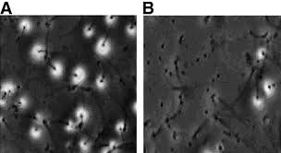
For normal samples or count > 10 mn / mL
Sub clinical Varicocele
ASA
Sperm structural and functional tests
  DNA Integrity
  Acrosome reaction

Slide 34
Haemospermia – USS / Culture /PSA
Hyper viscosity – Culture / Zn
Sperm agglutination – ASA test
Total immotile sample – Gene test for Kartagener syndrome

Slide 35
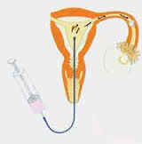
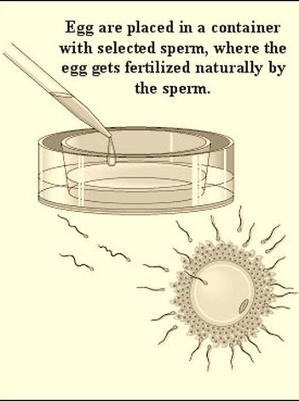
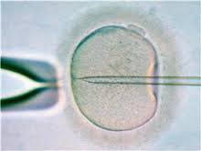
Treatment options
Surgical
Medical
Emphirical
ART
  IUI
  IVF
  ICSI

Slide 36
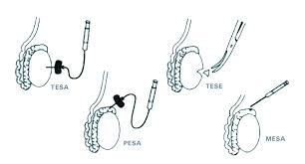
Sperm retrieval techniques for IVF/ICSI

